Slide 1

Lecture 1: Introduction of Deep Learning
Hands on Artificial Intelligence and Robotics
Lingxiao Wang, Ph.D.
Assistant Professor of Electrical Engineering
Louisiana Tech University
Some materials in this lecture are from Dr. Hung-Yi Lee’s Machine Learning 2022 Spring course. https://speech.ee.ntu.edu.tw/~hylee/ml/2022-spring.php

Slide 2

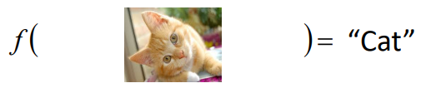
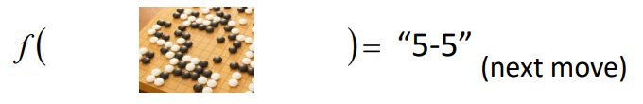
Machine Learning = Looking for Function
Speech Recognition
Input: sound wave signal; Output: text
Image Recognition
Input: image; output: the class of objects in the image
Playing the game of Go
Input: stone positions; output: next move

Slide 3
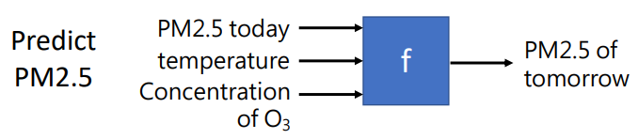
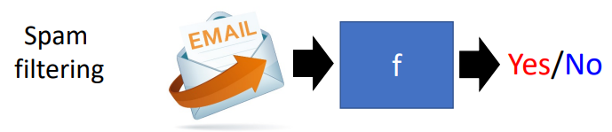
Different Types of Functions
There are Two MAIN types of functions
Regression: The function outputs a scalar.
Classification: Given options (i.e., classes), the function outputs the correct one.

Slide 4
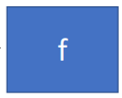

Different Types of Functions
Generative: the function generates text or images with the provided sequence (e.g., speech, text).
Machine Translation (provide text and the function translates the text into another language).
Image Generation (provide a description of image, the function generates the image).
Good Morning
おはよう
A girl with red eyes

Slide 5
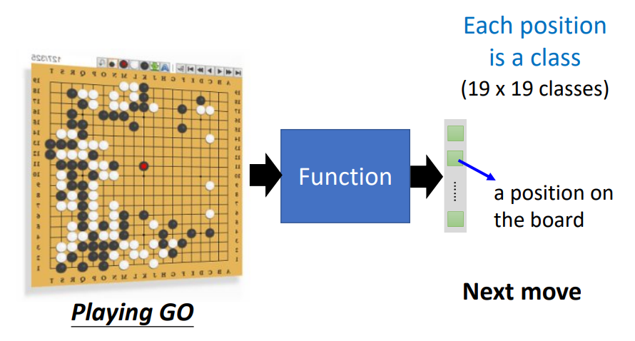
Different Types of Functions
Muti-class Classification: Given mutilple options (i.e., classes), the function outputs the correct one.

Slide 6
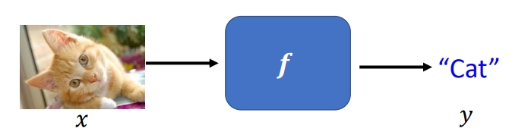
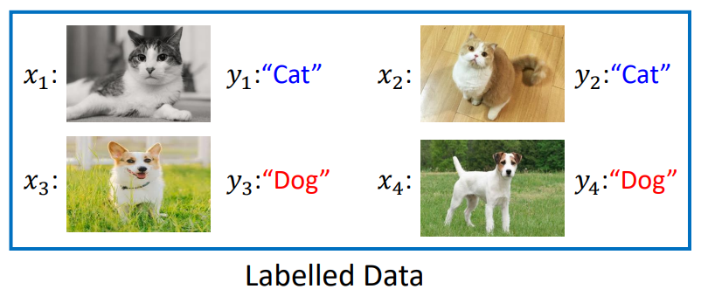
Supervised Learning
How to tell the machine what kind of function that we are looking for?
Supervised Learning: you let the machine know example inputs and outputs, and the machine will find the relationship between inputs and outputs, i.e., find the function.
For instance, you want to find a function that can distinguish cats/dogs from images.
So the input is a image (may contain or not contain cats/dogs) and the output is “Cat” or “Dog”.
You need to collect many examples (i.e., input & output pairs) to train this function. The collect of examples is called Labelled Data.

Slide 7
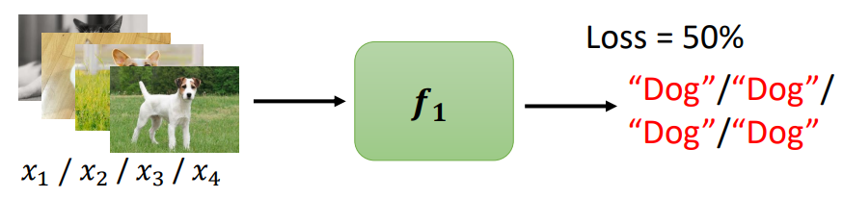
Supervised Learning (Continued)
In order to evaluate the function’s performance during the training, you need a loss function.
Loss function measures the distance from the current output to the correct output.
For instance, in the previous “Cat/Dog Distinguish” function:

Slide 8
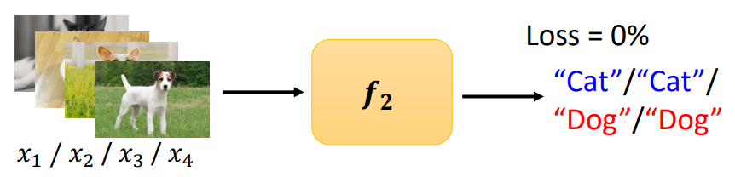

Supervised Learning (Continued)
For another example, if the output is:
Then the Loss is 0% since all estimations are correct.
Supervised training will find the function $f$ with the lowest loss value.

Slide 9
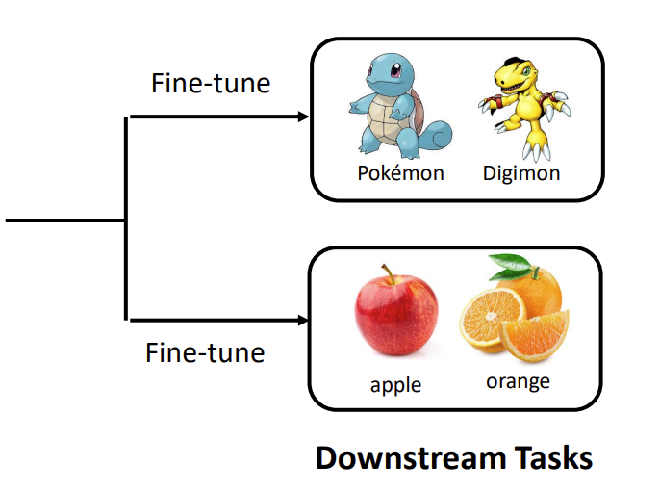
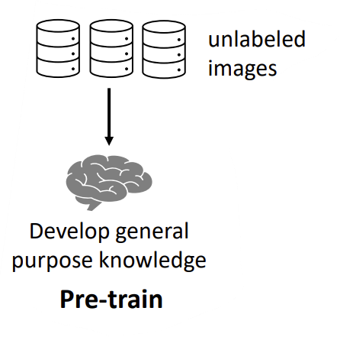
Self-Supervised Learning
Supervised learning needs labeled data.
It is not efficient to collect data for each task.
Self-supervised learning trains a function (i.e., a neural network) to learn one part of the input from another part of the input.
It is also called the pretext learning
For instance, train a model using unlabeled images to develop a general purpose knowledge (pre-train):
Then use a small amount of labeled data to solve the downstream tasks (fine-tune)

Slide 10
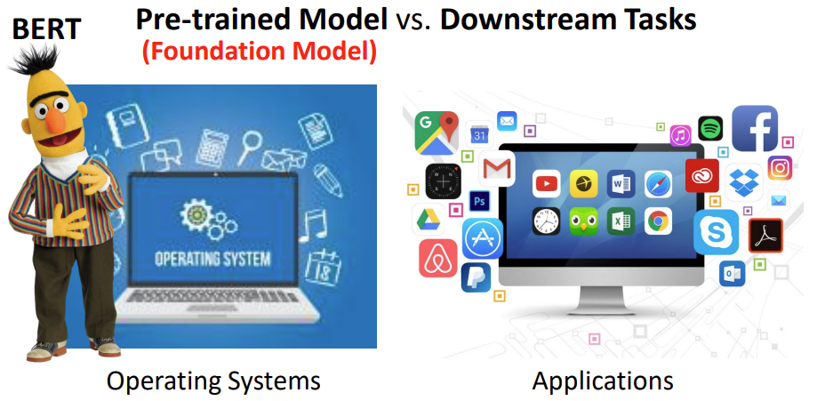
Self-Supervised Learning
Self-supervised learning idea is similar to operating systems and applications.
Pre-trained Model -> Operating system (foundation)
Downstream Tasks -> Applications (based on the foundation)

Slide 11
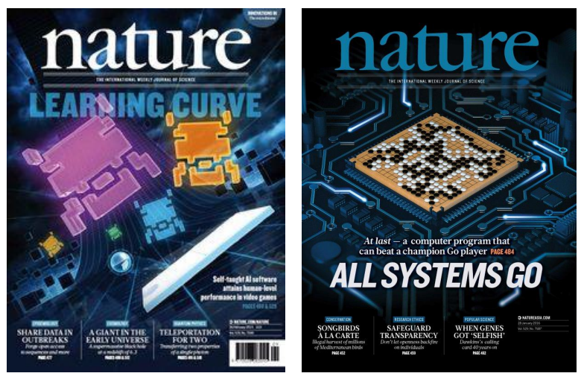
Reinforcement Learning
Reinforcement Learning gains attention in recent development
Alpha Go and Alpha Go Zero beat top human players in the game of Go.
These robots are trained with Reinforcement Learning.

Slide 12
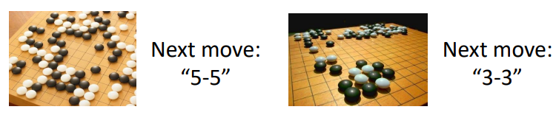
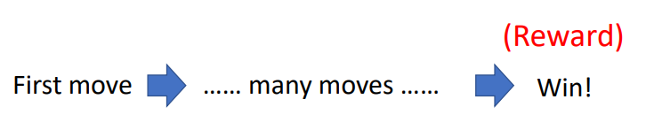
Supervised V.S. Reinforcement
Supervised Learning:
The machine needs an input and will find the output.
For instance, in the game of Go, the machine is given the current positions of black and white stones, the output should be the next move.
Reinforcement Learning:
The machine does not need input & output pairs during the training. It will find the optimal policy (i.e., a series of actions) via trial-and-error.
We need to define a reward to specify the training objective.

Slide 13
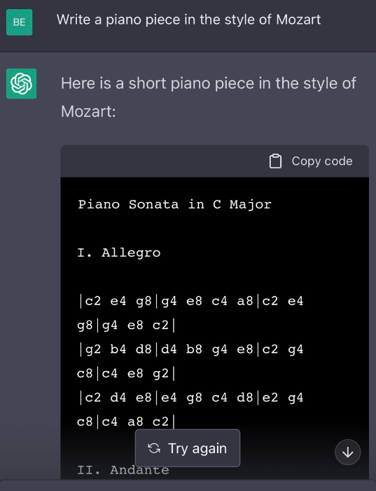
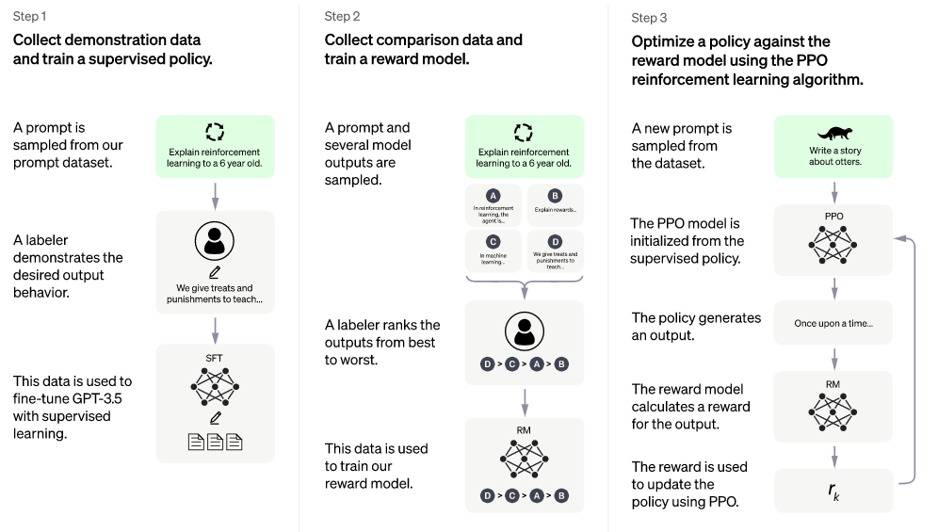
A Recent Reinforcement Learning Example: ChatGPT
ChatGPT:
A deep learning model (i.e., a function) that can interact with humans in a conversational way.
ChatGPT can answer questions, challenge incorrect premises, debug codes, write articles in different languages, etc. (try it by yourself: https://chat.openai.com/auth/login)
Method: Supervised Learning + Reinforcement Learning

Slide 14
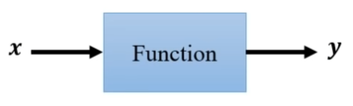
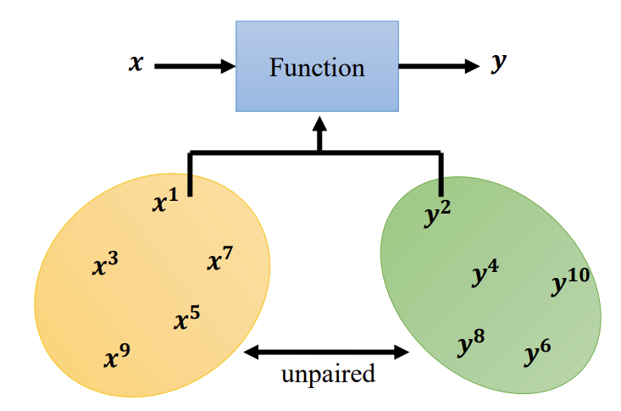
Unsupervised Learning: Generative Adversarial Network
In supervised learning, to learn a function, you need to provide both input and output pairs.
In generative adversarial network, you only need to collect input and output samples (they don’t need to be pairs).

Slide 15
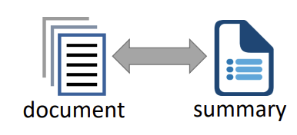

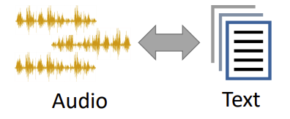
Unsupervised Learning: Generative Adversarial Network
Applications:
Unsupervised abstractive summarization
Unsupervised translation
Unsupervised audio to text generation

Slide 16
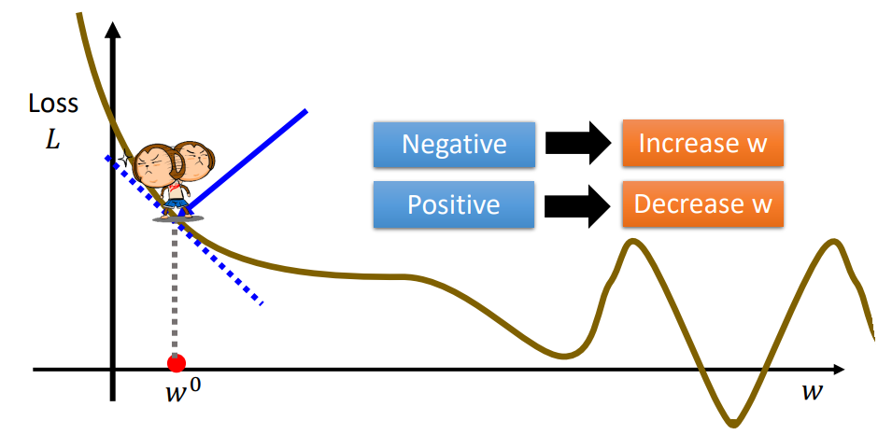
Gradient Descent
Gradient descent is a method to find the function.
For instance, in the supervised learning, once the loss function is define, we can use the Gradient Descent to find parameters that makes the loss function minimal.
If the gradient is negative, we increase the parameter values
If the gradient is positive, we decrease the parameter values.
Parameter Value

Slide 17
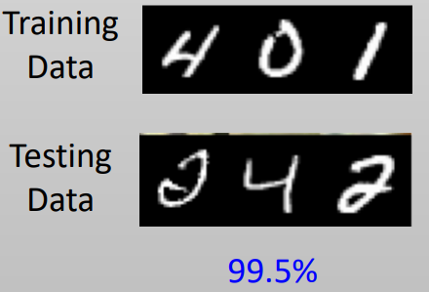
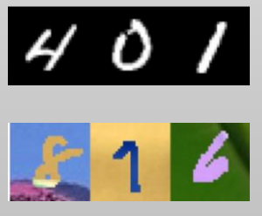
Transfer Learning (Domain Adversarial Learning)
Transfer Learning is a deep learning technology that can transfer the learned knowledge from one domain to another domain.
It has many applications.
For instance, if we have a machine that can distinguish “cats” and “dogs”, we can use transfer learning to make this machine distinguish “tigers” and “wolfs”.
Another example is to identify handwriting numbers.
If a machine can achieve high correct rate on identifying handwriting numbers with black and write background.
With transfer learning, it will also be able to identify handwriting numbers with a color background.

Slide 18
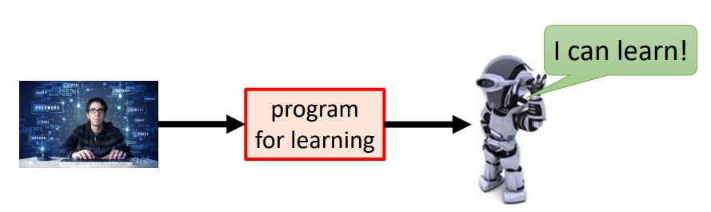
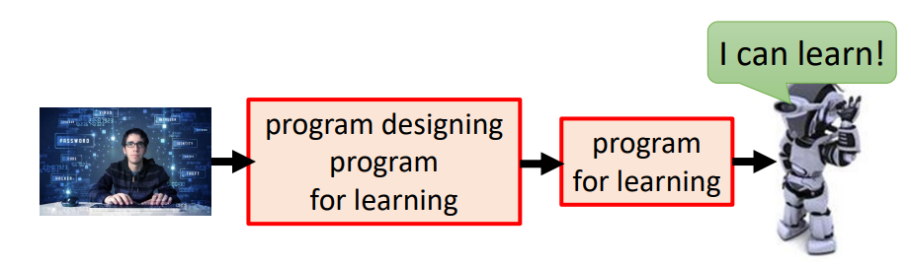
Meta Learning = Learn to Learn
In Deep/Machine Learning, humans define the program for learning
For instance, in the “Cats/Dogs distinguish” example the machine is provided will labeled images and the loss function, and we define the gradient descent algorithm to let the machine learn.
Now we design the learning algorithm, i.e., design a machine that knows how to learn new things.
Meta learning tries to find a program that can design program for learning.

Slide 19
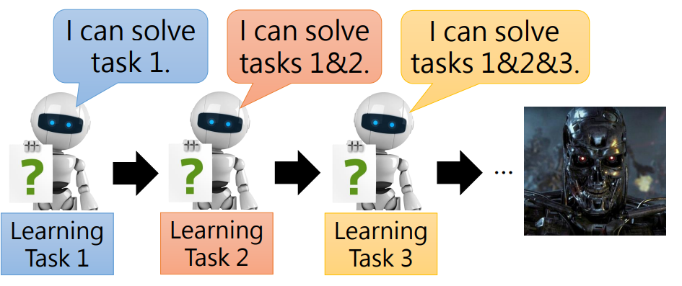
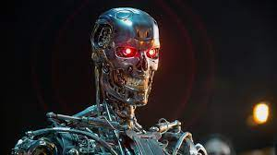
Life-Long Learning
Life-long learning is continuously let a machine to learn different tasks.

